Slide 1
Neeraj V
Sandeep K
Thara Raghunath
Vishnuchandra MC
Final project presentation.
GDP of India Forecasting using
Machine Learning.
Guided by : Sarith Sir

Slide 2
Index
Introduction
Existing system
Proposed system
About your proposed system
Design
Draw back of proposed system
Future work on the proposed system
Conclusion
Reference

Slide 3
Introduction
Forecasting macroeconomic variables is key to developing a view on a country's economic outlook.
GDP includes what is spent on environmental protection, healthcare, and education, but it does not include actual levels of environmental cleanliness, health, and learning.
GDP includes the cost of buying pollution-control equipment, but it does not address whether the air and water are actually cleaner or dirtier.
GDP includes spending on medical care, but it does not address whether life expectancy or infant mortality have risen or fallen.
GDP counts spending on education, but it does not address directly how much of the population can read, write, or do basic mathematics.
Overall we can say that GDP plays an immense role in the developing country like India.

Slide 4
Existing system
There has been an increasing amount of research on using large data sets to measure or predict macroeconomic indicators. The theoretical literature is adapting existing or developing new statistical and econometric methods for the analysis of large data sets with a large number of explanatory variables.
Many of the Indian data scientists are working together to find effective Machine learning model which gives accurate results.
There are so many effective algorithms used today, some of the algorithms gives effective results but not as much accurate. XG Boost, Light GDM, Decision Trees are effective algorithms used for GDP prediction.
Deep learning techniques can also be used.

Slide 5
Drawbacks of Existing system
Accuracy is not optimum and there is still room for improvement.
Focus on complete data: missing or corrupt data is generally unsupported.
Focus on linear relationships: assuming a linear relationship excludes more complex joint distributions.
Focus on fixed temporal dependence: the relationship between observations at different times, and in turn the number of lag observations provided as input, must be diagnosed and specified.
Focus on univariate data: many real-world problems have multiple input variables.
Focus on one-step forecasts: many real-world problems require forecasts with a long time horizon

Slide 6
Proposed System
The main aim of this project was to create a ML model that would help in predicting the expected GDP of each state of India with minimum margin of error for any given year in the future such as 2020 and beyond.
This is very beneficial since by this data we could predict he growth of different states of the country and it will be able to predict how the GDP must be used in an effective way for the benefit of the state.
We will analyze the latest dataset from https://niti.gov.in/ .
We will train the data and validate the data and uses various effective Machine Learning Algorithms which produce more accurate results.
We will also use some deep learning techniques for accurate results.
The major objective is to provide effective ML model which produces accurate result than the existing system.

Slide 7
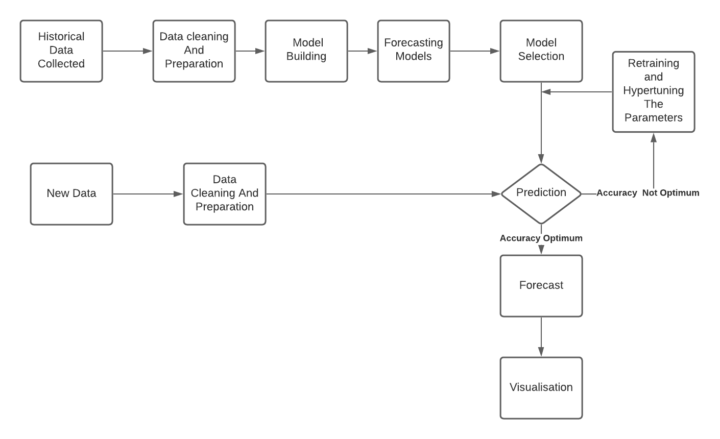
Design

Slide 8
Design: Experimental Phase
After the preprocessing of dataset, we experimentally used some machine learning and deep learning algorithms. These algorithms are especially regression models and every model is from python’s Scikit Learn Library.
These are the Machine Learning and Deep Learning algorithms that we used so far:
Linear Regression
Logistic Regression
MLP Regressor
LASSO
Before using these algorithms, The preprocessed data is split into two, and stored in X and Y variable.
Data splitting is the act of partitioning available data into two portions; usually for cross-validatory purposes. One portion of the data is used to develop a predictive model and the other to evaluate the model's performance. Here the X portion is used to develop a predictive model and Y portion is used to evaluate the models performance.

Slide 9
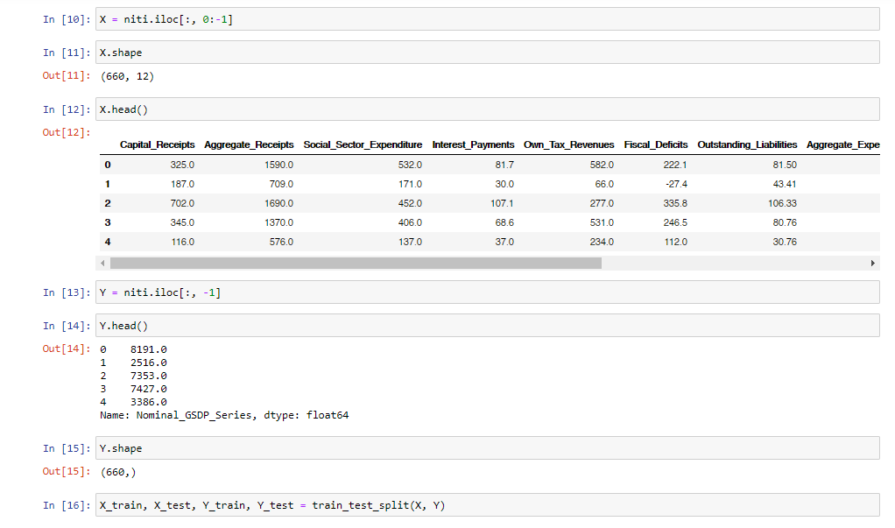
Splitting phase code:

Slide 10
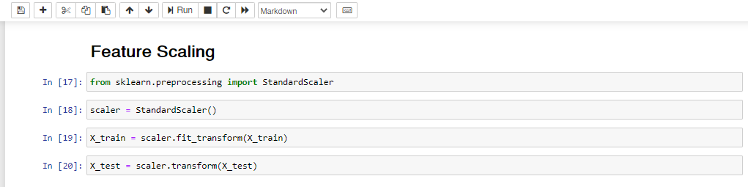
Before attempting to fit a model to observed data, first need to perform a feature scaling.
Feature scaling is a method used to normalize the range of independent variables or features of data. In data processing, it is also known as data normalization and is generally performed during the data preprocessing step

Slide 11
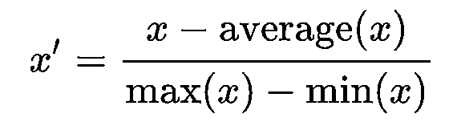
Here we used Mean-Normalisation and Transform
where x is an original value, x’ is the normalized value. There is another form of the means normalization which is when we divide by the standard deviation which is also called standardization.
The Resultant value is stored in X_test variable. The above steps similar in all the models.

Slide 12
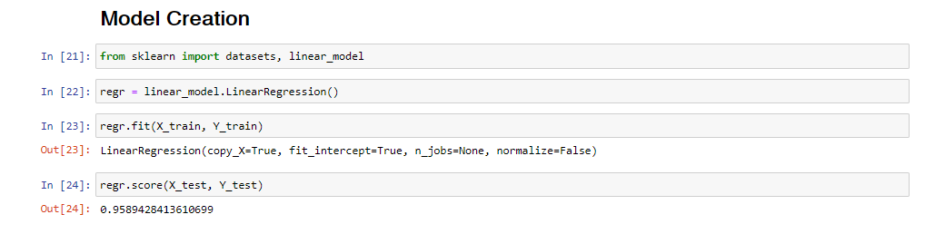
1.Linear Regression
Linear regression attempts to model the relationship between two variables by fitting a linear equation to observed data. One variable is considered to be an explanatory variable, and the other is considered to be a dependent variable (X and Y).

Slide 13
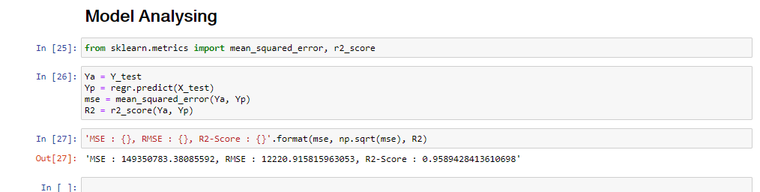
Result
Conclusion
Linear Regression model does not give accurate result that we expected, hence linear regression model is not feasible for our purpose.

Slide 14
2.Logistic Regression
Logistic regression is another technique borrowed by machine learning from the field of statistics.
It is the go-to method for binary classification problems (problems with two class values).
Logistic regression uses an equation as the representation, very much like linear regression.
Input values (x) are combined linearly using weights or coefficient values (referred to as the Greek capital letter Beta) to predict an output value (y). A key difference from linear regression is that the output value being modeled is a binary values (0 or 1) rather than a numeric value.
Below is an example logistic regression equation:
y = e^(b0 + b1*x) / (1 + e^(b0 + b1*x))
Where y is the predicted output, b0 is the bias or intercept term and b1 is the coefficient for the single input value (x). Each column in your input data has an associated b coefficient (a constant real value) that must be learned from our training data

Slide 15
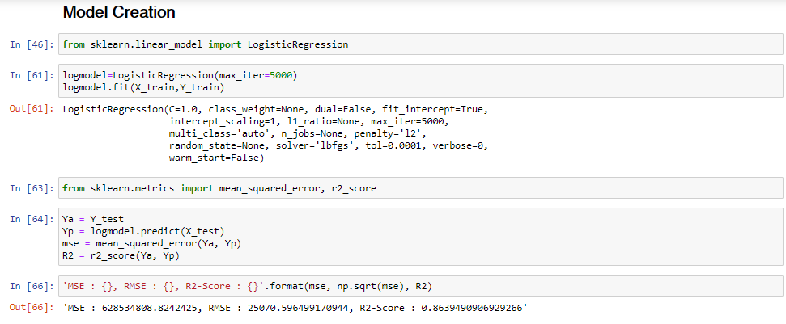
Conclusion
Logistic Regression model does not give accurate result that we expected, hence linear regression model is not feasible for our purpose.

Slide 16
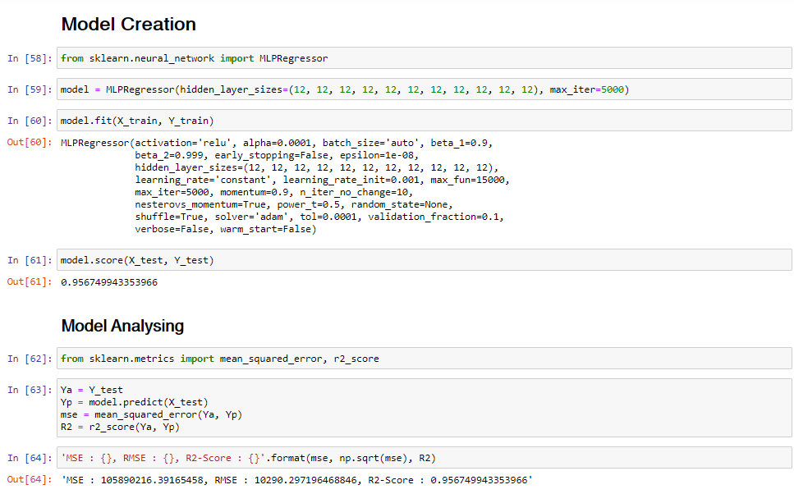
3.MLP Regressor
A sklearn.neural_network.MLPRegressor is a multi-layer perceptron regression system within
sklearn.neural_network

Slide 17
4.LASSO
lasso (least absolute shrinkage and selection operator; also Lasso or LASSO) is a regression analysis method that performs both variable selection and regularization in order to enhance the prediction accuracy and interpretability of the resulting statistical model
Lasso was originally formulated for linear regression models. This simple case reveals a substantial amount about the estimator. These include its relationship to ridge regression and best subset selection and the connections between lasso coefficient estimates and so-called soft thresholding. It also reveals that (like standard linear regression) the coefficient estimates do not need to be unique if covariates are collinear.

Slide 18
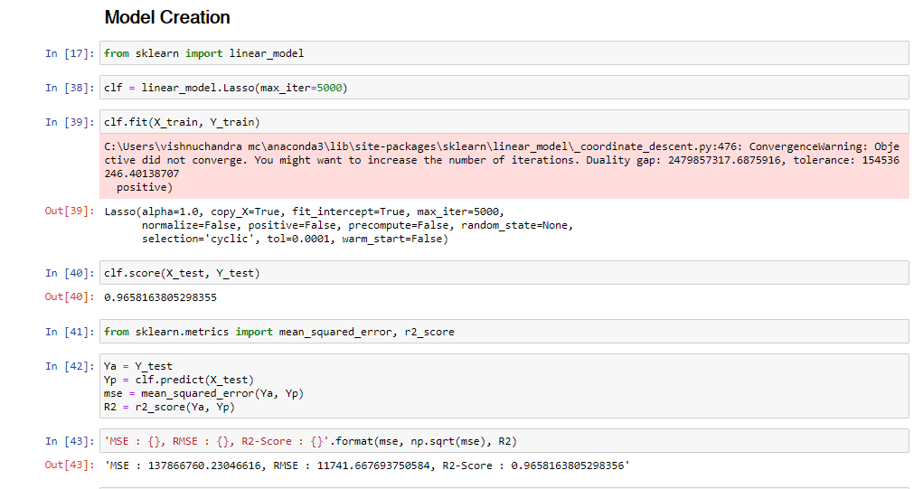
From the above Models We can conclude that MLPRegressor is accurate compared to other regressor methods, but these results are not satisfactory. These results does not meet our requirements hence we should not recommend these models for our future purpose.
Our next plan is to test with popular ML and DL models like LSTM or ARIMA that are perfect for timeseries forecasting.

Slide 19
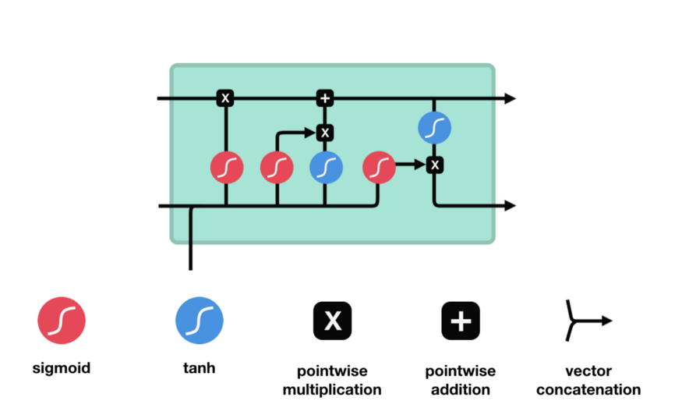
LSTM
The LSTM model proposed by Hochreiter et al. is a variant of the recurrent neural network (RNN).
It builds a specialized memory storage unit that trains the data through a time backpropagation algorithm.
It can solve the problem that the RNN has no long-term dependence. The schematic diagram of the LSTM structure is shown in Figure

Slide 20
The core concept of LSTM’s are the cell state, and it’s various gates.
The cell state act as a transport highway that transfers relative information all the way down the sequence chain.
The cell state can carry relevant information throughout the processing of the sequence.
So even information from the earlier time steps can make it’s way to later time steps, reducing the effects of short-term memory.
As the cell state goes on its journey, information get’s added or removed to the cell state via gates. The gates are different neural networks that decide which information is allowed on the cell state.
The gates can learn what information is relevant to keep or forget during training.
Three different gates regulate information flow in an LSTM cell. A forget gate, input gate, and output gate.

Slide 21
1.Forget gate
First, we have the forget gate. This gate decides what information should be thrown away or kept.
Information from the previous hidden state and information from the current input is passed through the sigmoid function. Values come out between 0 and 1. The closer to 0 means to forget, and the closer to 1 means to keep.

Slide 22
2.Input Gate
To update the cell state, we have the input gate.
First, we pass the previous hidden state and current input into a sigmoid function. That decides which values will be updated by transforming the values to be between 0 and 1.
0 means not important, and 1 means important.
You also pass the hidden state and current input into the tanh function to squish values between -1 and 1 to help regulate the network.
Then you multiply the tanh output with the sigmoid output. The sigmoid output will decide which information is important to keep from the tanh output.

Slide 23
3.Output Gate
The output gate decides what the next hidden state should be.
The hidden state contains information on previous inputs. The hidden state is also used for predictions.
First, we pass the previous hidden state and the current input into a sigmoid function. Then we pass the newly modified cell state to the tanh function.
We multiply the tanh output with the sigmoid output to decide what information the hidden state should carry.
The output is the hidden state. The new cell state and the new hidden is then carried over to the next time

Slide 24
Drawbacks of Proposed System
GDP is a macro economic indicator is dependent on many factors which are not included in the feature set.
Productivity from primary sector is highly uncertain as agriculture gets affected by seasonal changes and natural calamities.
Requires too much computational resources and time

Slide 25
Future Work on Proposed System
So far we done preprocessing or cleaning the data and making feature sets for the future use.
Our next step is selecting the effective machine learning model or deep learning model which gives accurate output.
Train and test data splitting
Prediction
Tuning it for increasing the accuracy
Final conclusion

Slide 26
Conclusion
Applications using Machine Learning are transforming our daily life.
ML methods have recently been proposed as alternatives to time series regression models being typically used.
Machine Learning algorithms outperform the statistical benchmarks.
By comparing the predictive accuracy of each model we tried to understand which would give us a better output.
Deep Learning models have an edge over ML models in terms of accuracy.
For our future work we are going to predict gdp using LSTM a Deep Learning method.

Slide 27
Reference
[1] Forecasting GDP using ARIMA and Artificial Neural Networks models under Indian environment published on International Journal of Mathematics Trends and Technology (IJMTT) – Volume 56 Number 1- April 2018
[2] IASSI Quarterly: Contributions to Indian Social Science, Vol. 37, Nos. 3 & 4, 2018 Predicting Regional Economic Activity using Artificial Intelligence (AI) Methods: Case Study with Indian States
[3] MPRA Paper No. 95459, posted 08 Aug 2019, Nowcasting US GDP with artificial neural networks
[4] Macroeconomic Indicator Forecasting with Deep Neural Networks Thomas R. Cook and Aaron Smalter Hall, September 29, 2017
[5]International Bussiness and Logistics Thesis,october 2017,GDP as a modern day economic indicator.

Slide 28
Thank you.

